Slide 1
Re
Your guide to the circular economy
Notes:
This is Re. Built by Cora Fu, Eli Carlin-Coleman, and Kristina Gorobets

Slide 2
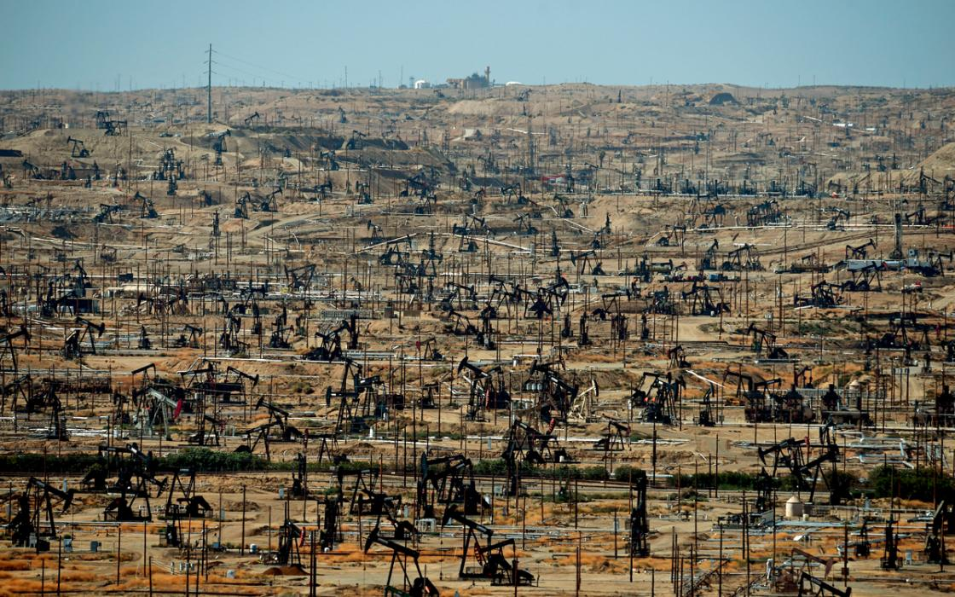
How humans extract energy:
Notes:
Currently, 80% of our energy comes from fossil fuels. These are non-renewable resources, which exist in finite quantities, and whose use disrupts the natural cycles on Earth

Slide 3
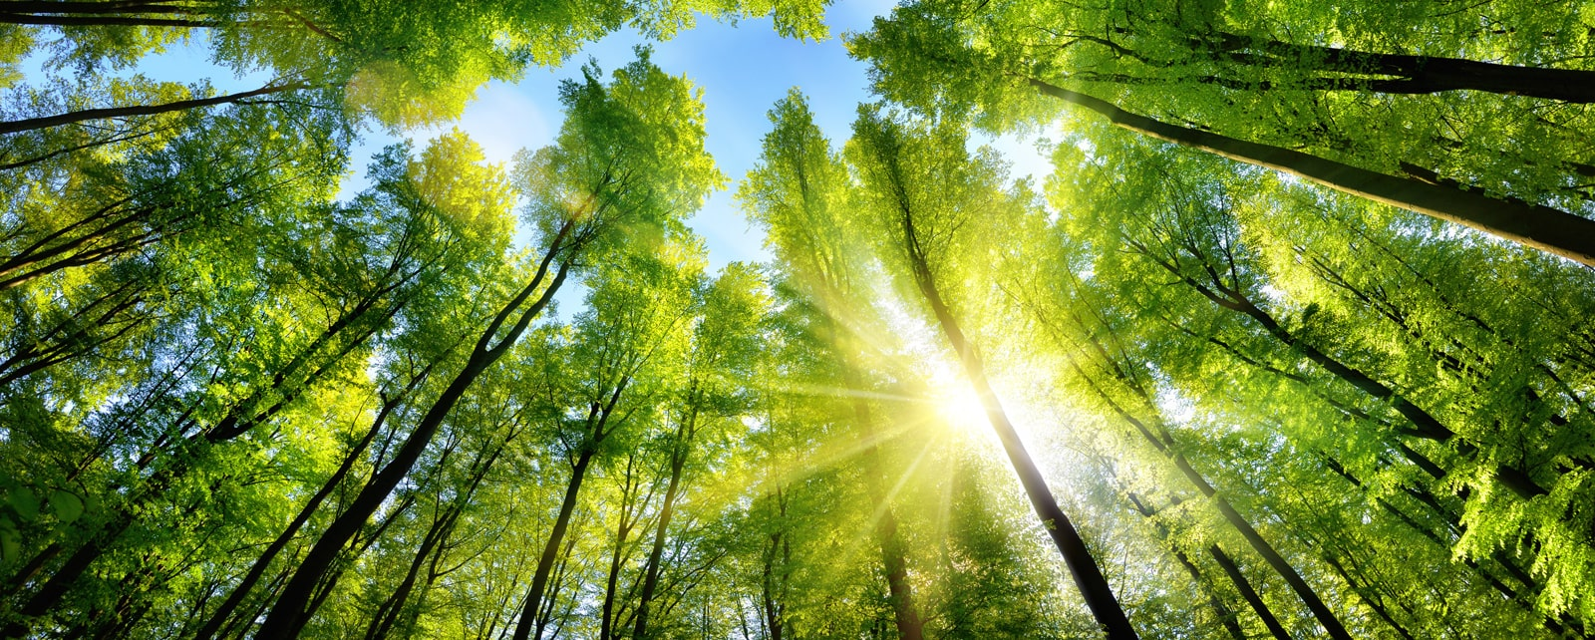
How nature extracts energy:
Notes:
Natural systems source their energy from the sun. This is a source that does not diminish with use, and is built into natural cycles.

Slide 4
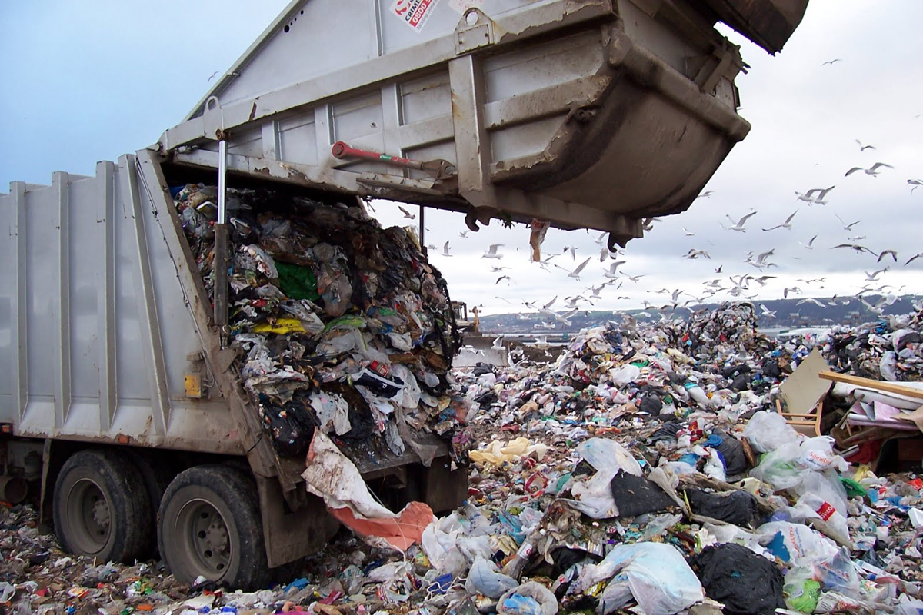
How humans dispose of waste:
Notes:
Humans dispose of waste by leaving it in landfills, dumping it into the ocean, or burning it and spewing the fumes into the air. There is no process by which this waste can be broken down, so it simply stays where we put it for hundred of years, disrupting anything that tries to grow.

Slide 5
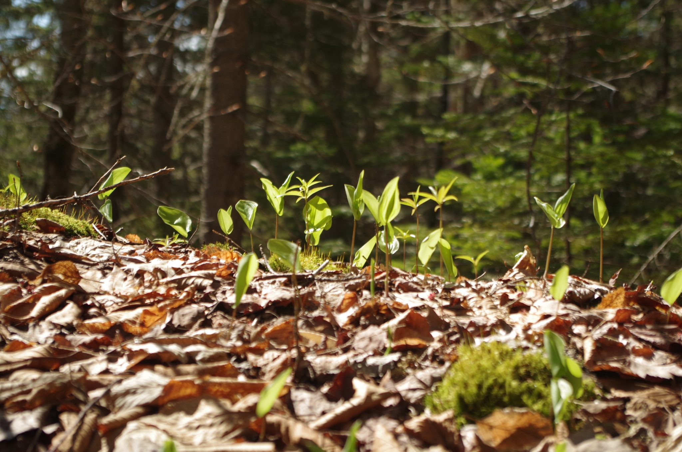
How nature disposes of waste:
Notes:
Natural systems have waste too. But their waste is constantly being reabsorbed into the natural cycle, remaining waste only for a few months, before it becomes the very soil in which new life can grow.

Slide 6
Nature thrives in cycles
How can we survive without them?
Notes:
If we want to live on this planet, we will need to learn to live like the plants.

Slide 7
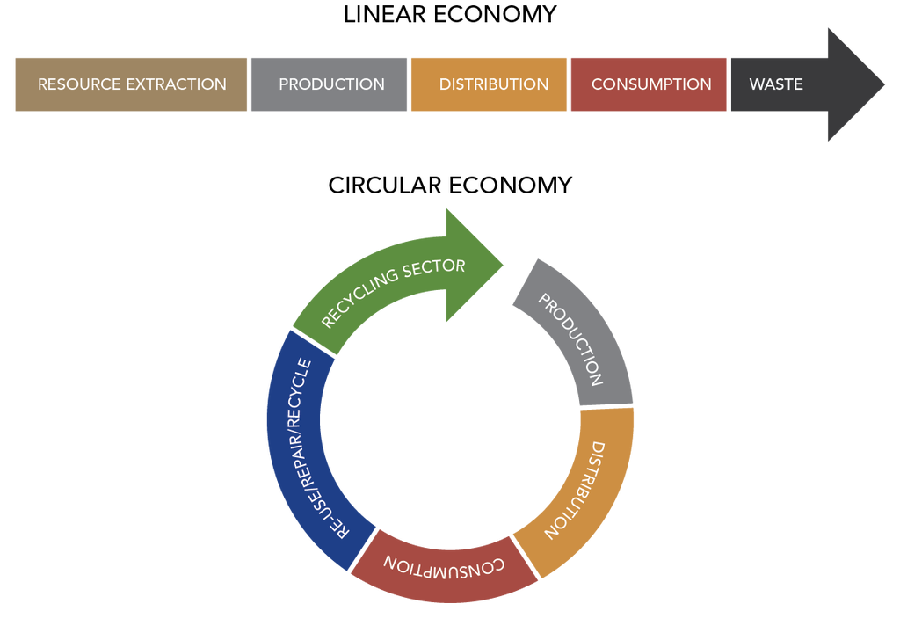
What if we could go from this:
Notes:
Our current economy goes from cradle to grave. We extract, use, and dispose, sometimes within months.

Slide 8
To this:
Notes:
To mimic nature, we need a cradle-to-cradle economy, where we extract as little as possible, use and reuse for as long as possible, and dispose of our waste responsibly.

Slide 9
Introducing Re.
Your guide to the circular economy
Notes:
Re is your guide to the circular economy.

Slide 10
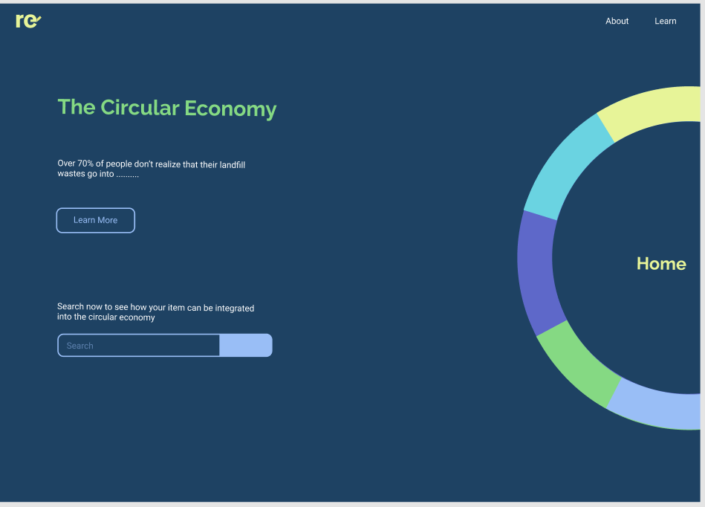
Notes:
Re will teach you the what, the why, and most importantly the how of use and reuse

Slide 11
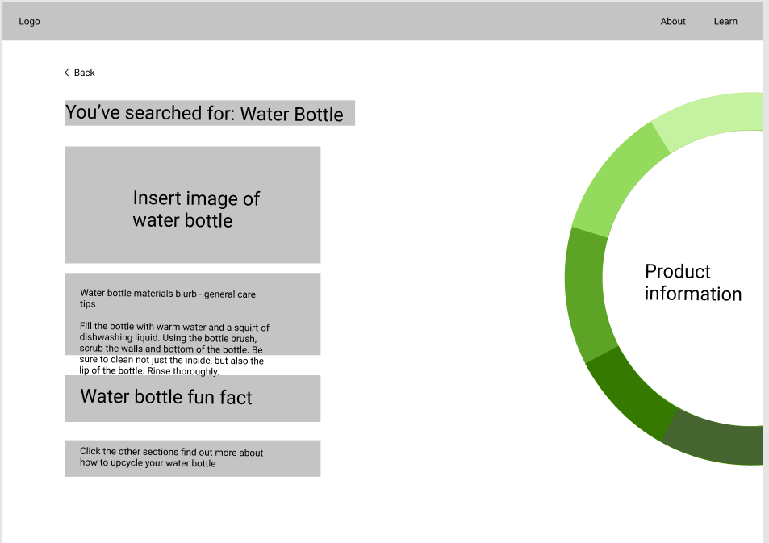

Slide 12
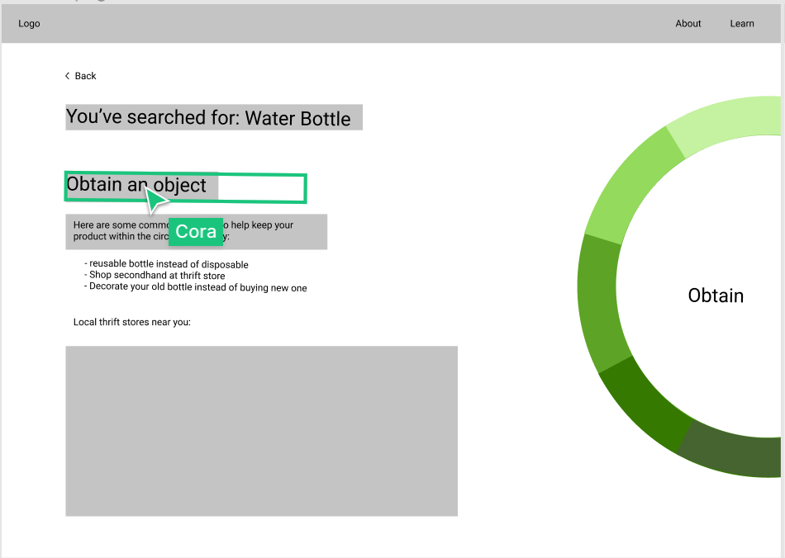

Slide 13
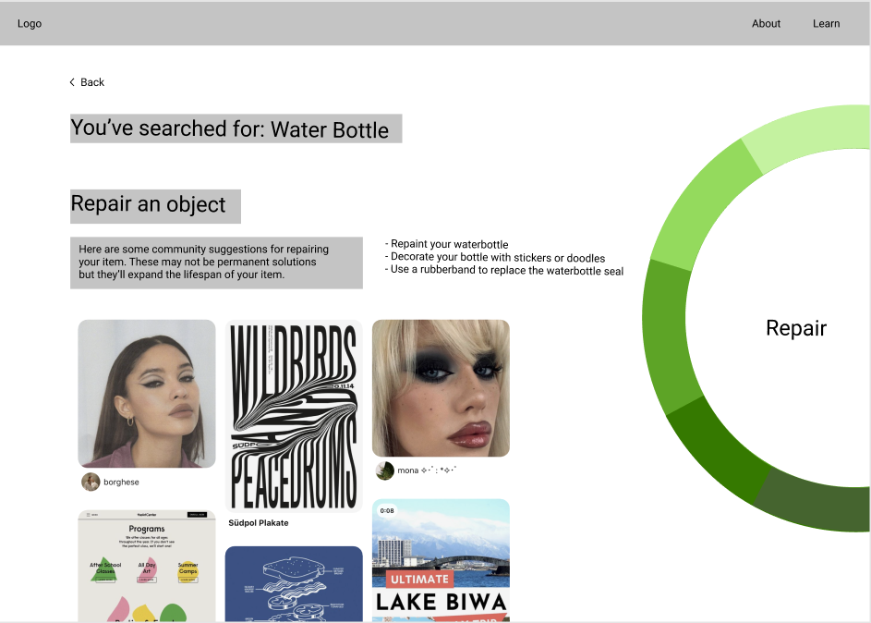

Slide 14
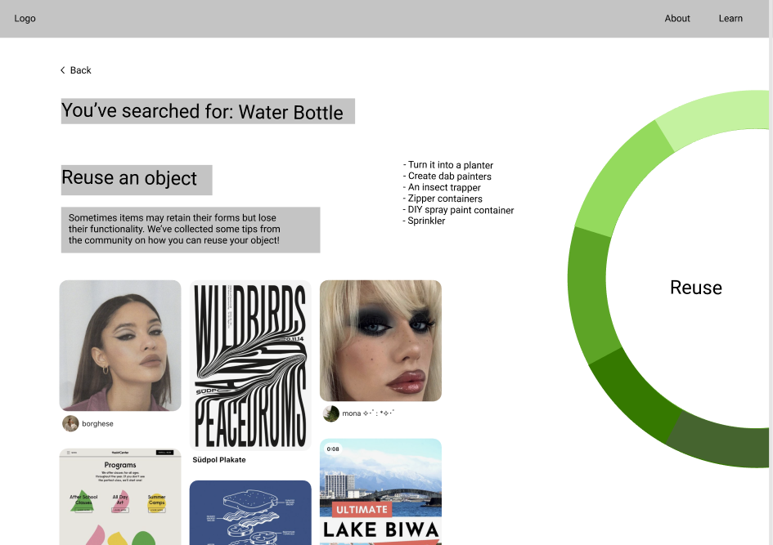

Slide 15
